Slide 1


Cloud computing
for education and research
Practice 02. Spring cloud

Slide 2
Routing and filtering with API G/W
06
Foundation
Designed to provide authentication, load, canary testing, dynamic routing, and active/active multi-region traffic management capabilities
Spring cloud gateways provide a simple and effective way to route to APIs and provide common interests such as security, monitoring/metrics, resistance, and more

Slide 3
Routing and filtering with API G/W
06
Using Netflix Zuul
Spring Cloud implements built-in Zuul proxy that allows front-end apps to call back-end services
Zuul is useful for external clients (front end)
It hides system complexity and helps avoid the need to manage cross-origin-resource-sharing (CORS) and authentication concerns that enforce access control over the various domains that make up web pages to enhance security
Use @EnableZuulProxy Annotation for main class to enable Zuul
Zuul is integrated with ribbon load balancer, hystrix, circuit breaker, Eureka
Do not expose the network addresses of all micro-services running inside the system
Share a single edge network address that delivers all incoming requests to the appropriate service

Slide 4
Message-driven microservices
07
Application Development
external client
G/W service
8080
Order service
Customer service
8092
8090
Product service
Account service
8093
8091

Slide 5
Routing and filtering with API G/W
06
Using Netflix Zuul
Use spring-cloud-starter-Zuul starter
Apply @EnableZuulProxy Annotation to the main class
server:
port: ${PORT:8080}
Zuul:
ignoredServices: '*'
routes:
account:
path: /account/**
url: http://localhost:8091
customer:
path: /customer/**
url: http://localhost:8092
order:
path: /order/**
url: http://localhost:8090
product:
path: /product/**
url: http://localhost:8093
http://localhost:8080/account/1 ----> http://localhost:8091/1
Do not ignore only the services defined here

Slide 6
Routing and filtering with API G/W
06
Interworking with Service Discovery
Key requirements for API G/W are interworking with embedded service discovery
To enable service discovery with eureka on Zuul, include spring-cloud-starter-eureka and attach @EnableDiscoveryClientAnnotation to the main class
G/W should not register itself with the discovery server. All you need to do is get a list of currently registered services. Therefore, the eureka.client.registerWithEureka attribute is false
Zuul:
routes:
account-service:
path: /account/**
customer-service:
path: /customer/**
order-service:
path: /order/**
product-service:
path: /product/**

Slide 7
Routing and filtering with API G/W
06
Customizing the route configuration
Ignore registered services: Zuul exposes all services registered on the eureka server.
To avoid automatic registration, the discovery server must register a pattern in the Zuul.ignored-services property that matches all service names that you want to ignore
Zuul:
ignoredServices: ‘account-service’

Slide 8
Routing and filtering with API G/W
06
To explicitly name a service
The service name of the discovery server can be set in the configuration using the served attribute.
Zuul:
routes:
accounts:
path: /account/**
serviced: account-service
customers:
path: /customer/**
serviced: customer-service
orders:
path: /order/**
serviced: order-service
products:
path: /product/**
serviced: product-service

Slide 9
Routing and filtering with API G/W
06
Defining Routes with Ribbon Clients
Eureka Discovery is disabled and only a list of network addresses provided in the listOfServer properties of the ribbon client is available.
All requests coming into the G/W are load-distributed through the ribbon client to all service instances by default.
This rule is valid whether or not Service Discovery is used.
Zuul:
routes:
accounts:
path: /account/**
serviced: account-service
ribbon:
eureka:
enabled: false
account-service:
ribbon:
listOfServers: http://localhost:8091, http://localhost:9091

Slide 10
Routing and filtering with API G/W
06
Adding a Prefix to a Path
Occasionally, it is necessary to set a different path for the service to be called via G/W rather than allowing the service to be called directly.
In this case, Zuul provides the ability to add prefixes to all defined mappings.
This is configured via Zuul.prefix property
Zuul:
prefix: /api
routes:
accounts:
path: /account/**
serviced: account-service
customers:
path: /customer/**
serviceId: customer-service

Slide 11
Routing and filtering with API G/W
06
Connection Settings and Timeouts
Zuul's primary mission is to route incoming requests to downstream services, so HTTP clients must be implemented for service and communication
The default HTTP client that Zuul uses is based on the Apache HTTP Client
The ribbon.restclient.enabled property must be true to use the ribbon.
You can also try the OkHttpClient with the ribbon.okhttp.enable property as true.
There are two options, depending on service discovery availability
If you define a juul route that uses a specified network address using the url property without service discovery, set zuul.host.connect-timeout-millis and zuul.host.socket-timeout-millis, zuul.host.maxtotalconnection,
Zuul.host.maxPerRouteConnections.
If the zuul is set to retrieve a list of services from service discovery, the same timeout as the ribbon.ReadTimeout and ribbon.SocketTimeout properties must be configured.Definable using ribbon.MaxTotalConnections and ribbon.MaxConnectionsPerHost

Slide 12
Routing and filtering with API G/W
06
Enhanced header security
When an Authorization HTTP header is set i a request, it is not delivered to a subsequent service
This is because Zuul removes sensitive headers defined by default in the routing process. These headers include Cookie, Set-Cookie, and Authorization.
This feature is designed to view communication with external servers0
SensitiveHeaders default can be overridden and used: the empty list must be explicitly set to forward all headers
Zuul:
routes:
accounts:
path: /account/**
sensitiveHeaders:
serviced: account-service

Slide 13
Routing and filtering with API G/W
06
End Point Management
Spring Cloud Netflix Zuul exposes two additional management endpoints for monitoring.
Routes: Outputs a list of defined routes
Filters: Outputs a list of filters
The management endpoint feature must include spring-cloud-starter-actuator dependency
For testing, it is recommended to disable endpoint security by setting the management.security.enabled property to false

Slide 14
Routing and filtering with API G/W
06
Zuul filter
Prefilter: Used to prepare the initial data of RequestContext for use downstream of the filter. The primary role is to set the necessary information in the route filter
Route filter: Runs after prefilter and generates a request to another service because it is required to convert the request or response to the model required by the client
Post filter: Used to manipulate responses frequently
Error filter: Run only if there are exceptions to other filters

Slide 15
Routing and filtering with API G/W
06
Predefined filters
Using the @EnableZuulProxy announcement for the main class, the spring cloud Zuul will load the filter bin used by both SimpleRouteLocator and DiscoveryClientRouteLocator
ServletDetectionFilter:checking for requests coming through spring dispatchers
FormBodyWrapperFilter: parsing and encoding form data for downstream requests
PreDecorationFilter: Decide where to forward requests based on the RouteLocator provided
SendForwardFilter: Transfer requests using RequestFispatcher
RibbonRoutingFilter:RouteFilter.Using the Ribbon HTTP Client
SimpleHostRoutingFilter:RouteFilter.Sending requests via Apache HTTP client
SendResponseFilter:postfilter

Slide 16
Routing and filtering with API G/W
06
Using Spring Cloud G/W
Route: Configures a route, destination URL, a list of conditions, and a unique ID to identify a list of filters
Predicates: Finds whether various HTTP requests, such as headers and input values, meet the defined criteria
Filters: This allows you to modify incoming or outgoing HTTP requests

Slide 17
Routing and filtering with API G/W
06
Built-in conditioners and filters
After route: Receive the Date-time input and map subsequent requests
Before route: Get a Date-time input and map requests that occurred before that
Cookie route: Take the cookie name and regular expression as input, find the cookie in the header of the HTTP request, and compare the value to the provided expression
Header route: Take header name and regular expression as input to find a specific header in the header of the HTTP request and compare the value to the provided expression
Host route:.entered host name ANT style pattern using delimiter and matched with host header
Method route: Get HTTP method as input value and compare
Path Route: takes the pattern of the request contact path as an input value and compares it
QueryRoute: Two input values - receive the requested input and optional regex and compare with the query input
RemoteAddrRoute: Receive a list of IP addresses in a CIDR expression and compare it to the remote address in the request

Slide 18
Routing and filtering with API G/W
06
Implementation of Additional Gateway Filter Patterns
AddRequestHeader
AddRequestParameter
AddResponseHeader
Hystrix: gets input for hystrix command name
PrefixPath: Adding a prefix to an HTTP request path to an input value
RequestRateLimiter: Limit the number of requests processed by a single
user based on the three inputs provided
……
spring:
cloud:
gateway:
routes:
- id: example_route
uri: http://localhost:8080
filters:
- AddRequestHeader=X-Request-ID, 123
- PrefixPath =/api

Slide 19
Distributed logging and tracking
06
Logging and Tracking
Tracking is to follow the program's data flow, used by technical support to locate the problem
Track system flow to determine when bottlenecks or errors occur
Logging is used for error reporting and detection
ELK stack is used a lot (Elasticsearch+Logstash+Kibana)
Spring Cloud uses Java logging frameworks such as logback or Log4j
Zipkin: Used in micro-service architecture to resolve delay issues.
It collects timing data and is a typical tracking tool
It is good that all micro-services have the same message format. JSON format recommendation

Slide 20
Distributed logging and tracking
06
Level of Log Information
TRACE: Very detailed information and development
DEBUG: used for debugging and troubleshooting
INFO: leaving the most important information in operation in this log
WARN: Logs all events that may cause errors at this level
ERROR: Leave exceptions at this level
FATAL: Leaving significant error events with potential to disrupt apps as this level log

Slide 21
Distributed logging and tracking
06
Logging with Spring Boot
Apache Commons Logging is used for internal logging, but Logback is used by default in the app when dependencies are included using a starter
Provides configurations for Java Util Logging, Log4J2, and SLF4J
Logging settings are configured using logging.* properties in the application.yml file
Default log output contains the date, time, log level, process ID, thread name, full class name that output the log, and message, in milliseconds
Springboot leaves logs only on the console. Set logging.file or logging.path property to leave files outside of the console. Log files accumulate in new files after reaching 10M size
The last item that can be overridden in the application.yml settings file is the log level
Springboots leave messages at ERROR, WARN, and INFO levels by default
Logging.level.* Properties can be overridden by package or class
Root Logger can be configured as logging.level.root

Slide 22
Distributed logging and tracking
06
Logging with Spring Boot
logging:
file: logs/order.log
level:
com.netflix: DEBUG
org.springframework.web.filter.CommonsRequestLoggingFilter: DEBUG
pattern:
console: “%d{HH:mm:ss.SSS} %-5level %msg%m”
file: “%d{HH:mm:ss.SSS} %-5level %msg%n”
Additionally, to define appender and filter, you must include a configuration for log systems such as logback, Log4j2, and Java Util Logging.
The spring boot uses logback as the default
Providing logback-spring.xml to the root class path overrides all settings defined in application.yml

Slide 23
Distributed logging and tracking
06
Collecting Integrated Logs Using an ELK Stack
elasticsearch (ES): Suitable for apps that require full text search in cross-platform environments
ES offers REST, JSON-based APIs for scalability, flexibility and retrieval of stored data
Es can save and retrieve app logs
Logstash: Supports various inputs to extract events from external sources. It provides various outputs, and can also be output in elasticsearch. It can store events in Apache Kafka, Rabbit MQ, and Montgomery, and can store metrics in influxDB and Graphite
Kibana: The last element in the ELK stack. The data visualization plug-in. It can easily represent and filter all logs collected in the app by creating search queries

Slide 24
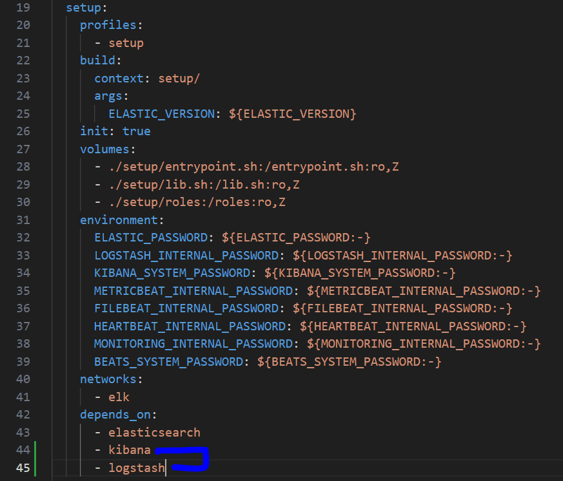
Distributed logging and tracking
06
Create Docker-elk to proceed with the test
git clone https://github.com/deviantony/docker-elk
cd docker-elk
Modifying .env and docker-compose files

Slide 25
Distributed logging and tracking
06
Create Docker-elk to proceed with the test
docker-compose up setup
docker-compose up -d (run with daemon)

Slide 26
Distributed logging and tracking
06
Configure the ELK stack on the machine
contents of the pipeline/logstash.conf file
Logstash container must be floated and input and output defined
Output is elasticsearch
Defining logstash-input-tcp TCP flog-in as input This is compatible with LogstashTcpSocketAppender, which is used as a logging
companion for apps
Here, all logs of the microservices are exported in JSON format
The json codec for the plug-in must be set
Each microservice is indexed by name and micro prefix in ElasticSearch.
input {
tcp {
port => 50000
codec => json
}
}
output {
elasticsearch {
hosts => ["http://192.168.99.101:9200"]
index => "micro-%{appName}"
}
}

Slide 27
Distributed logging and tracking
06
Configure the ELK stack on the machine
The following is the logstash.conf configuration file in Logstash.
input {
tcp {
port => 50000
codex => json
}
}
output {
hosts => [“http://192.168.99.100:9200”]
index => “micro-%{appName}”

Slide 28
Distributed logging and tracking
06
Integrating apps and ELK stacks
How to use Filebeat to deliver data from local files. The logstash-input-beats input setting is to be a logstash instance and is the default option. Filebeat daemon must be installed and run on the server machine
How to set up a configuration based on Logback and a dedicated appender. The appender is within the Logstash JSON encoder project. To use it, declare net.logstash.logback.appender.logstashSocketAppender appender in the logback-spring.xml file.
You can also use a message broker to deliver data to the logstash.

Slide 29
Distributed logging and tracking
06
Using LogstashTCPAppender
The Logstash-logback-encoder library provides three approaches: UDP, TCP, and asynchronous. Among them, TCP appenders are the most used
Defines an afforder using the LogstashTCPAppender class in the logback configuration file.
App should add logstash-logback-encoder dependency
All TCP adapters must configure their own encoders. At this time, you can choose between Logstash Encoder and Logging Event Complex Json Encoder
LoggingEventCompositeJsonEncoder provides more freedom and consists of one or more JSON providers mapped to JSON output

Slide 30
Distributed logging and tracking
06
Call getLogger in org.slf4j.LoggerFactory to use logback as a logger on SLF4J
Using LogstashTCPAppender
private static final Logger LOGGER = LoggerFactory.getLogger(OrderController.class);
private ObjectMapper mapper = new ObjectMapper();
@Autowired
OrderRepository repository;
@Autowired
AccountClient accountClient;
@Autowired
CustomerClient customerClient;
@Autowired
ProductClient productClient;
@PostMapping
public Order prepare(@RequestBody Order order) throws JsonProcessingException {
int price = 0;
List<Product> products = productClient.findByIds(order.getProductIds());
LOGGER.info("Products found: {}", mapper.writeValueAsString(products));

Slide 31
Distributed logging and tracking
06
Using LogstashTCPAppender
Customer customer = customerClient.findByIdWithAccounts(order.getCustomerId());
LOGGER.info("Customer found: {}", mapper.writeValueAsString(customer));
for (Product product : products)
price += product.getPrice();
final int priceDiscounted = priceDiscount(price, customer);
LOGGER.info("Discounted price: {}", mapper.writeValueAsString(Collections.singletonMap("price", priceDiscounted)));
Optional<Account> account = customer.getAccounts().stream().filter(a -> (a.getBalance() > priceDiscounted)).findFirst();
if (account.isPresent()) {
order.setAccountId(account.get().getId());
order.setStatus(OrderStatus.ACCEPTED);
order.setPrice(priceDiscounted);
LOGGER.info("Account found: {}", mapper.writeValueAsString(account.get()));
} else {
order.setStatus(OrderStatus.REJECTED);
LOGGER.info("Account not found: {}", mapper.writeValueAsString(customer.getAccounts()));
}
Map<String, String> m = MDC.getCopyOfContextMap();
return repository.add(order);
}

Slide 32
Distributed logging and tracking
06
Using LogstashTCPAppender
<appender name="STASH" class="net.logstash.logback.appender.LogstashTcpSocketAppender">
<destination>192.168.99.100:50000</destination>
<encoder
class="net.logstash.logback.encoder.LoggingEventCompositeJsonEncoder">
<providers>
<mdc />
<context />
<logLevel />
<loggerName />
<pattern>
<pattern>
{
"appName": "order-service"
}
</pattern>
</pattern>
<threadName />
<message />
<logstashMarkers />
<stackTrace />
</providers>
</encoder>
</appender>

Slide 33
Distributed logging and tracking
06
Using an AMQP Appender and a Message Broker
Using spring AMQP appenders and message brokers makes the configuration more complex
Message broker must be enabled
Create a queue to post incoming events and connect to the exchange
To do this, log in to the Rabbit Management Console, create a queue called q_logstash in the Queue section, and define an exchange called ex_logstash
Start the RabbitMQ instance, configure it, and start the interworking on the application side
Include spring-boot-starter-amqp dependency in the project to provide implementations of AMQP clients and AMQP appliances
Use the org.springframework.amqp.rabbit.logback.
AmqpAppender class to define an afforder in the logback configuration file
<dependency>
<groupId>org.springframework.boot</groupId>
<artifactId>spring-boot-starter-amqp</artifactId>
</dependency>

Slide 34
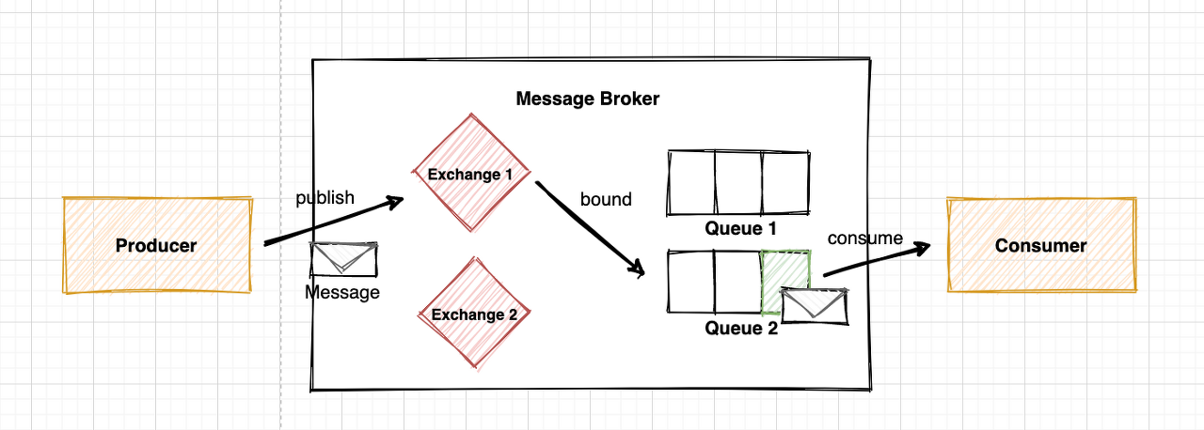
Distributed logging and tracking
06
Rabbit MQ installation
docker run -d -- --name rabbitmq -p 5672:5672 -p 15672:15672 rabbitmq:management
message delivering type
Direct: Send message to queue with exact matching routing key
Topic: Send message to queue with matching routing key pattern
Headers: Send message to matching queue based on header value consisting of [key:value]
Fanout: Send message to all queues registered in the relevant Exchange

Slide 35
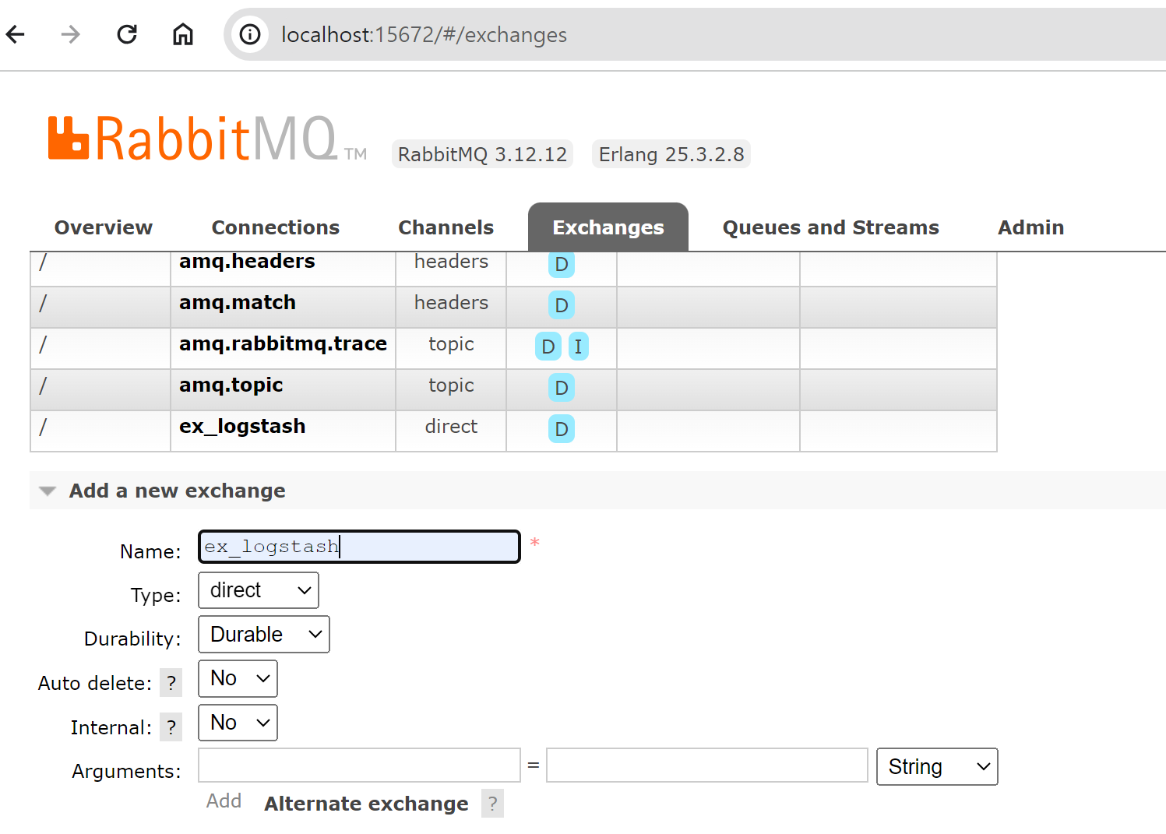
Distributed logging and tracking
06
Rabbit MQ installation
1. make exchange

Slide 36
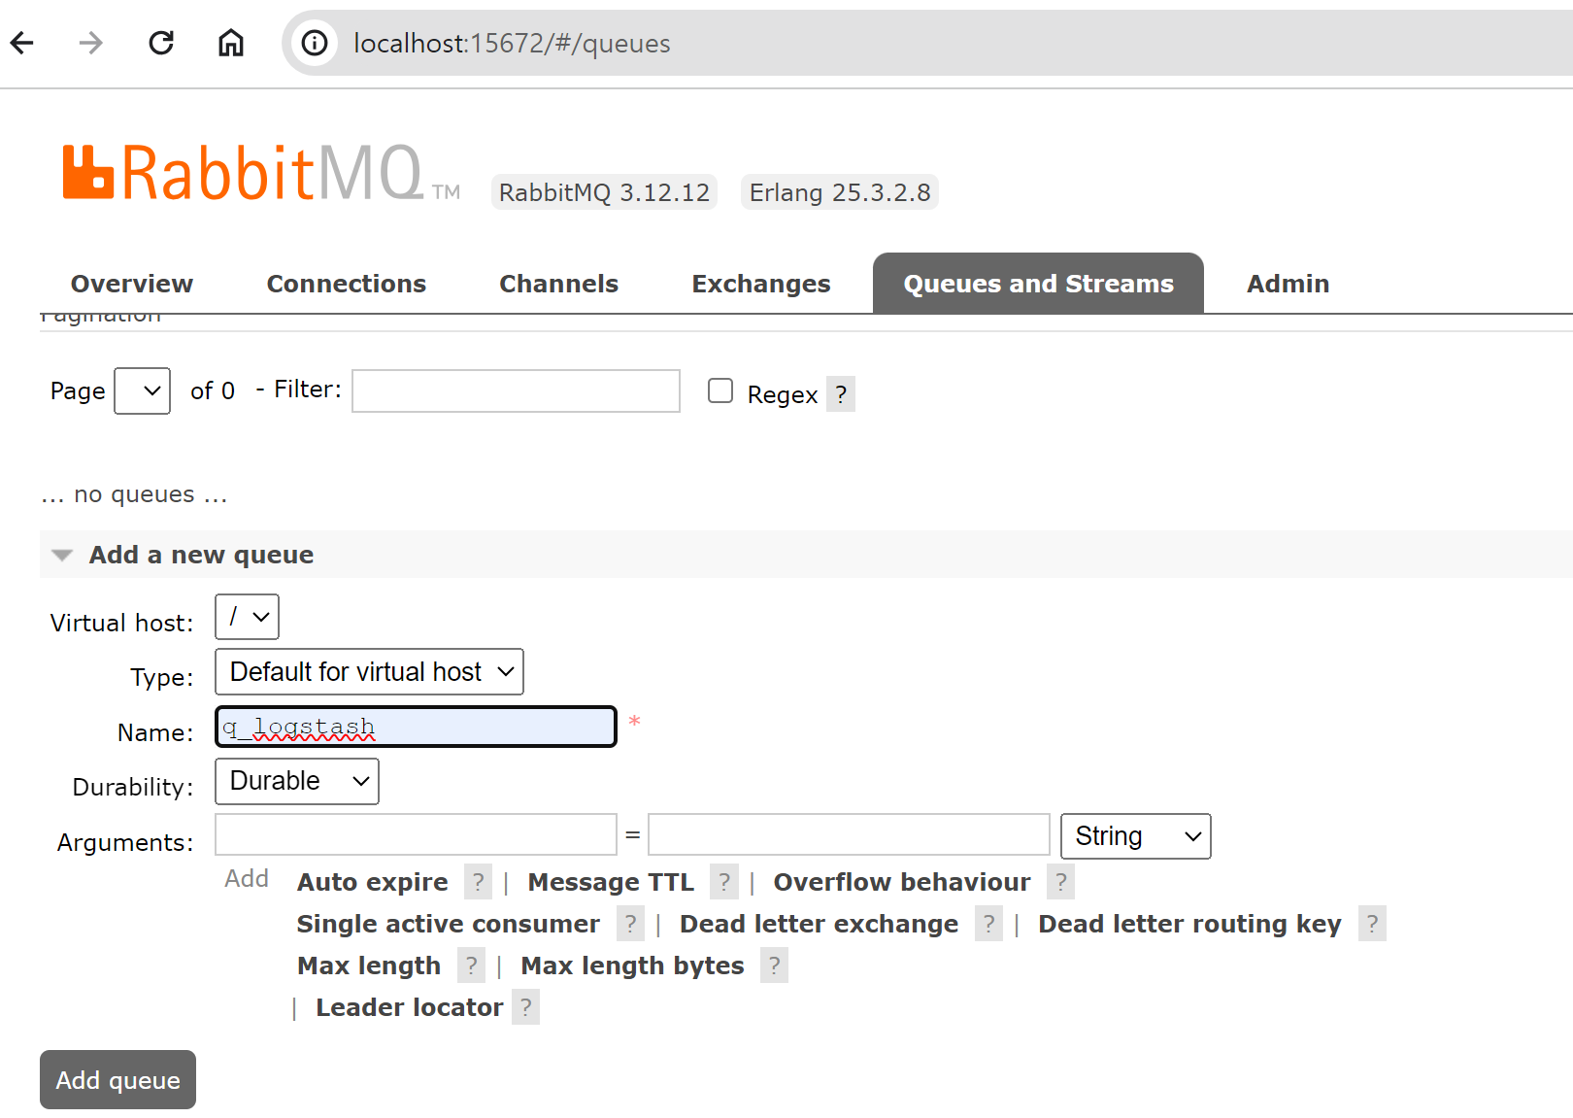
Distributed logging and tracking
06
Rabbit MQ installation
1. make queue

Slide 37
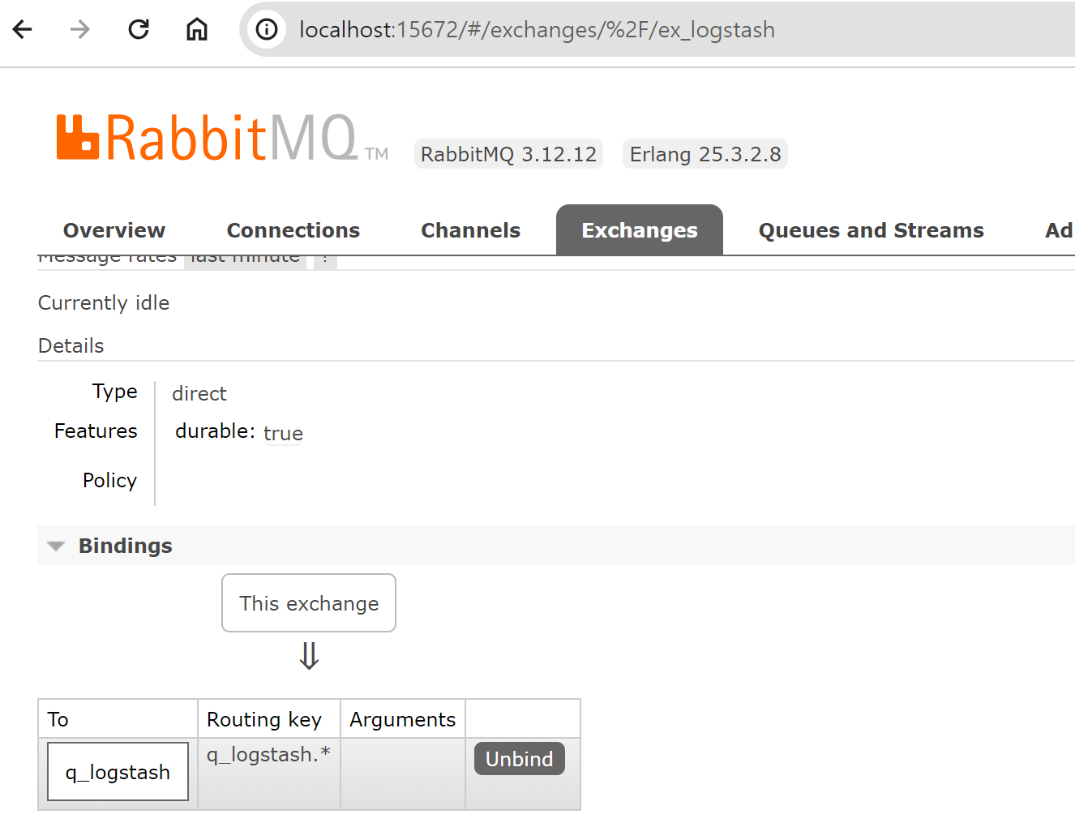
Distributed logging and tracking
06
Rabbit MQ installation
1. make bindings

Slide 38
Distributed logging and tracking
06
Using an AMQP Appender and a Message Broker
<appender name="AMQP" class="org.springframework.amqp.rabbit.logback.AmqpAppender">
<layout>
<pattern>
{
"time":"%date[ISO8601]",
"thread": "%thread",
"level":"%level",
"class":"%logger{36}",
"message":"%message"
}
</pattern>
</layout>
<host>localhost</host>
<port>5672</port>
<username>guest</username>
<password>guest</password>
<applicationId>account-service</applicationId>
<routingKeyPattern>account-service</routingKeyPattern>
<exchangeType>direct</exchangeType>
<exchangeName>ex_logstash</exchangeName>
<generateId>true</generateId>
<charset>UTF-8</charset>
<durable>true</durable>
<deliveryMode>PERSISTENT</deliveryMode>
</appender>

Slide 39
Distributed logging and tracking
06
Using an AMQP Appender and a Message Broker
Connecting a Logstash to Rabbitmq
input {
rabbitmq {
host => “192.168.99.100”
port => 5672
durable => true
exchange => “ex_logstash”
}
}
output {
elasticsearch {
hosts => [“http://192.168.99.100:9200”]
}
}

Slide 40
Distributed logging and tracking
06
Spring Cloud sleuth
It is important to correlate messages exchanged by apps when processing requests that enter the system in a microservice environment
Can link incoming requests to messages and responses exchanged between independent apps
These connections are defined as span and trace
Span refers to a single exchange in which a response is sent in response to a request
Trace is called correlation IT, which helps connect all logs generated by various apps while processing requests that enter the system
Since all traces and span IDs are added to the mapped diagnostic context (Slf4J MDC), all logs related to traces or span may be extracted from the log aggregator.
The MDC is a map that stores the contact data of the current thread
Each thread is accessible to its MDC value during the thread life cycle.

Slide 41
Distributed logging and tracking
06
Spring Cloud sleuth
Spring Cloud sleuth Adds Next 2 Spans To MDC
appName: Name of the app that creates the log entry
exportable: Specify whether logs should be exported to Zipkins
It provides a general distributed tracking data model that is abstracted and can be integrated with Zipkin
Timing information is recorded to aid in delay analysis
Provides integration with common spring components participating in communications such as servlet filters, asynchronous endpoints, RestTemplate, message channels, Zuul filters, Feign clients, etc

Slide 42
Distributed logging and tracking
06
Integrating apps with sleuth
Add spring-cloud-starter-sleuth starter to dependency
sleuth automatically adds HTTP headers of X-B3-SpandId and X-B3-TraceId to all requests and responses
This field is included in the MDC as spanId and traceId and can be viewed in the log
If Kibana is used as an integrated log collector with a field generated by sleuth, it is easy to find log entries using trace or span ID.

Slide 43
Distributed logging and tracking
06
Integrating Zipkin with sleuth
Zipkin helps to gather timing data needed to analyze delays in micro-service-based architectures
Zipkin UI provides dependency diagram showing how many tracked requests have been processed across all apps
Running a Zip-In Server
docker run -d —name zipkin –p 9411:9411 openzipkin/zipkin
installing zipkin-server dependencies
spring:
application:
name: zipkin-service
server:
port: ${PORT:9411}

Slide 44
Distributed logging and tracking
06
Zipkin Client App Development
Spring-cloud-starter-zipkin dependencies must be included
spring:
zipkin:
baseUrl: http://192.168.99.100:9411/
For service discovery and integration, spring.zipkin.locator.discovery.enabled is true when using the client through @EnableDiscoveryClient in the app
spring:
zipkin:
baseUrl: http://zipkin-service/

Slide 45
Distributed logging and tracking
06
Analyzing Data with Zipkin ui
Ensure that all micro-services, including G/W services, use zipkin tracking
sleuth uses the value of spring.application.name as the service name of the span by default
Run the Gateway ControllerTest implemented Junit test to test Zipkin
spring:
zipkin:
baseUrl: http://192.168.99.100:9411/

Slide 46
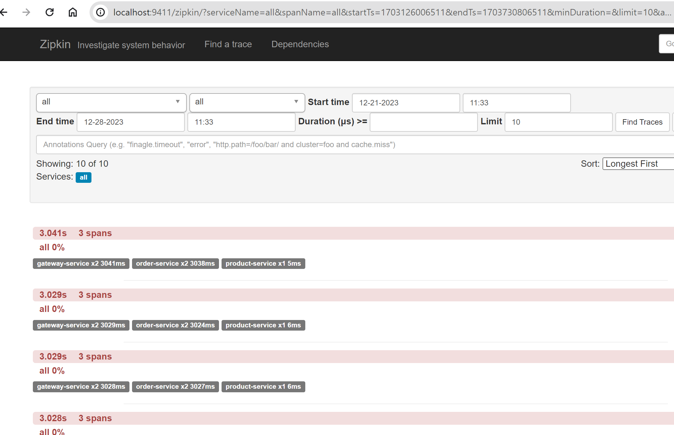
Distributed logging and tracking
06
Analyzing Data with Zipkin ui

Slide 47
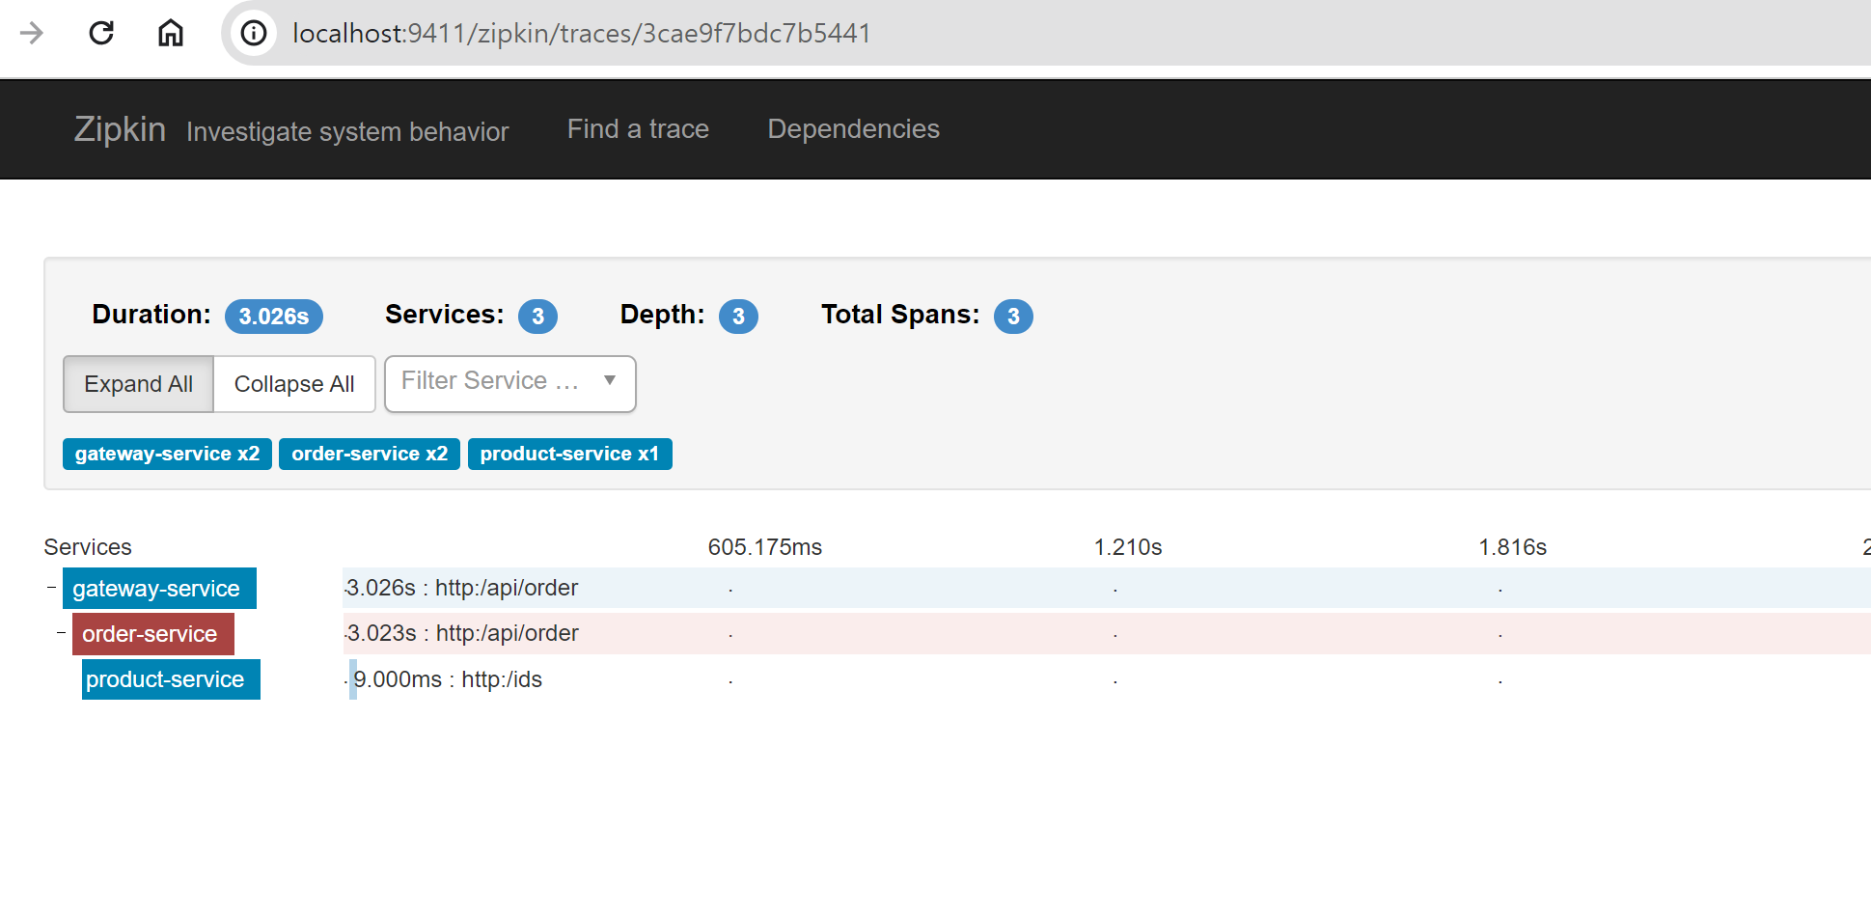
Distributed logging and tracking
06
Analyzing Data with Zipkin ui

Slide 48
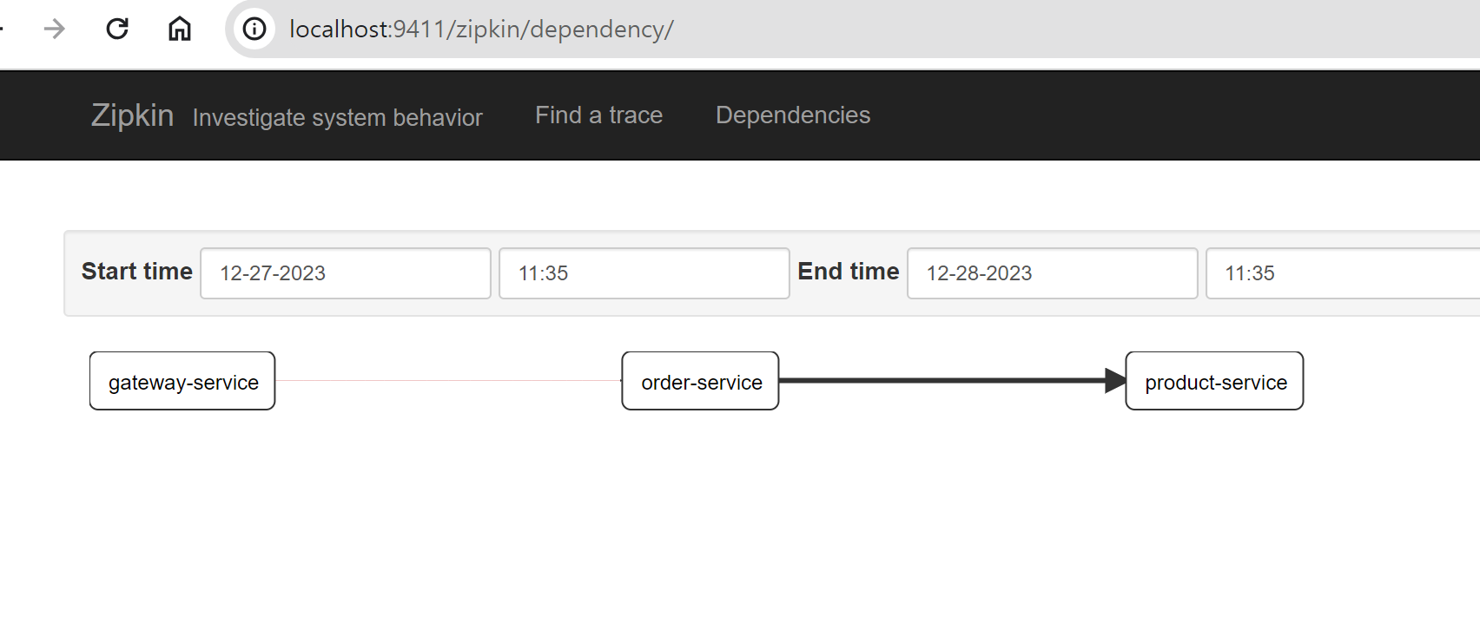
Distributed logging and tracking
06
Analyzing Data with Zipkin ui

Slide 49
Distributed logging and tracking
06
Integration via message broker
Clients must include spring-cloud-starter-zipkin and spring-rabbit dependencies
Zipkin servers must contain spring-cloud-sleuth-zipkin-stream and spring-cloud-starter-stream-rabbit
The Zip-In Server App is organized as follows
@SpringBootApplication
@EnableZipkinStreamServer
@EnableDiscoveryClient
public class ZipkinApplication {
public static void main(String[] args) {
new SpringApplicationBuilder(ZipkinApplication.class).web(true).run(args);
}
}

Slide 50
Message-driven microservices
07
Spring Cloud Stream
Spring Cloud Stream Developed based on Spring Boot
This allows for the use of Spring Integration, which creates a standalone spring app at an operational level and helps implement communications using a message broker
Connects with external message brokers and enables implementation of two built-in binders, Kafka and Rabbit MQ
Spring intergration is intended to support enterprise integration patterns (EIPs)
external client
G/W service
Product service
Order service
message
broker
Account service

Slide 51
Message-driven microservices
07
Spring Cloud Stream
Add spring-cloud-stream to dependency, and spring-cloud-sleuth is also added.
Use the @EnableBinding announcement in the main class to activate the connection to the message broker in the app. This announcement takes one or more interfaces as input values. At this time, you can select three interfaces provided by the spring cloud stream
Sink: Represents the service that receives messages from the incoming channel
source: used to send a message to the channel where the message leaves
Processor: used when both incoming and outgoing channels are required

Slide 52
Message-driven microservices
07
Spring Cloud Stream: Example
@SpringBootApplication
@EnableBinding(Processor.class)
@EnableDiscoveryClient
public class OrderApplication {
public static void main(String[] args) {
new SpringApplicationBuilder(OrderApplication.class).web(true).run(args);
}
}

Slide 53
Message-driven microservices
07
Declare and bind a channel
Spring Integration frees apps from implementing message brokers
Spring cloud streams automatically find and use binders in class paths
This means that you can choose a different type of middleware and use it for the same code
Middleware-specific settings can be redefined as external configurations in the form of application inputs, environmental variables, and application.yml supported by the spring boot
To include Kafka Support, include the following dependencies: spring-cloud-starter-stream-kafka
After activating the spring cloud stream and including the binder implementation, a sender and a listener may be created.
<dependency>
<groupId>org.springframework.cloud</groupId>
<artifactId>spring-cloud-starter-stream-rabbit</artifactId>
</dependency>
<dependency>
<groupId>org.springframework.cloud</groupId>
<artifactId>spring-cloud-starter-stream-kafka</artifactId>
</dependency>

Slide 54
Message-driven microservices
07
Declare and bind a channel
Assuming that you create a producer responsible for sending a new order message to a broker, it is as follows.
@Service
public class OrderSender {
@Autowired
private Source source
public Boolean send(Order order)
return this.source.output().send(MessageBuilder.withPayload(order).build());
}
}

Slide 55
Message-driven microservices
07
Declare and bind a channel
The controller that can place a new order is as follows.
@RestController
public class OrderController {
private static final Logger LOGGER = LoggerFactory.getLogger(OrderController.class);
private ObjectMapper mapper = new ObjectMapper();
@Autowired
OrderRepository repository;
@Autowired
OrderSender sender;
@PostMapping
public Order process(@RequestBody Order order) throws JsonProcessingException {
Order o = repository.add(order);
LOGGER.info("Order saved: {}", mapper.writeValueAsString(order));
boolean isSent = sender.send(o);
LOGGER.info("Order sent: {}", mapper.writeValueAsString(Collections.singletonMap
("isSent", isSent)));
return o;
}

Slide 56
Message-driven microservices
07
Declare and bind a channel
Send a message containing order information to the message broker. In order for the account-service to receive this message, it must declare the receiver waiting for the message in the queue generated by the broker.
@SpringBootApplication
@EnableDiscoveryClient
@EnableFeignClients
@EnableBinding(Processor.class)
public class AccountApplication {
private static final Logger LOGGER = LoggerFactory.getLogger(AccountApplication.class);
private ObjectMapper mapper = new ObjectMapper();
@Autowired
AccountService service;
public static void main(String[] args) {
new SpringApplicationBuilder(AccountApplication.class).web(true).run(args);
}
@StreamListener(Processor.INPUT)
public void receiveOrder(Order order) throws JsonProcessingException {
LOGGER.info("Order received: {}", mapper.writeValueAsString(order));
service.process(order);
}

Slide 57
Message-driven microservices
07
Declare and bind a channel
spring:
application:
name: account-service
rabbitmq:
host: 192.168.99.100
port: 5672
cloud:
stream:
bindings:
output:
destination: orders-in
input:
destination: orders-out
rabbit:
bindings:
output:
producer:
exchangeType: direct
routingKeyExpression: '"#"'
input:
consumer:
exchangeType: direct
two applications use the same exchange as input and output when connecting to labbitMQ
Exchange is automatically created
Create an exchange with the input name of the @Input channel and the output name of the @Output channel

Slide 58
Message-driven microservices
07
Declare and bind a channel
Exchange list available at http://localhost:15672 (guest:guest)
In some cases, two input/output message channels need to be defined.
Because each message is point-to-point communication to RabbitMQ direct exchange, which is handled by exactly one consumer
In this case, you must declare the two interfaces @Input, @Output method
MessageChannel for outgoing communication and SubscribableChannel for incoming communication. For example, the ProductOrder interface can be created as follows
public interface ProductOrder {
@Input
SubscribableChannel productOrdersIn();
@Output
MessageChannel productOrdersOut();
}
Run a test
curl -H "Content-Type: application/json" -X POST -d '{"customerId":1,"productIds":[1,3,4],"status":"NEW"}' http://localhost:8080/api/order

Slide 59
Message-driven microservices
07
Integrate with other spring cloud projects
REST API, Message Broker, Feign can also be used
The following is the implementation of the product-service of the Feign client in the account-service module
Thanks to the spring cloud sleuth, all messages exchanged in relation to requests entering the system via G/W have the same traceId
Log integration tools such as synchronous REST, asynchronous messages, standard log files, and elastic stacks can be easily tracked and associated between microservices
@FeignClient(name=“product-service”)
public interface ProductClient {
@PostMapping(“ids”)
List<Product> findByIds(@RequestBody List<Long> ids);
}

Slide 60
Message-driven microservices
07
Integrate with other spring cloud projects
rabbitMQ broker
Product service
external client
G/W service
product-orders-in
Order service
product-orders-out
Account service
account-orders-in
account-orders-out
logstash
kibana
elastic
search

Slide 61
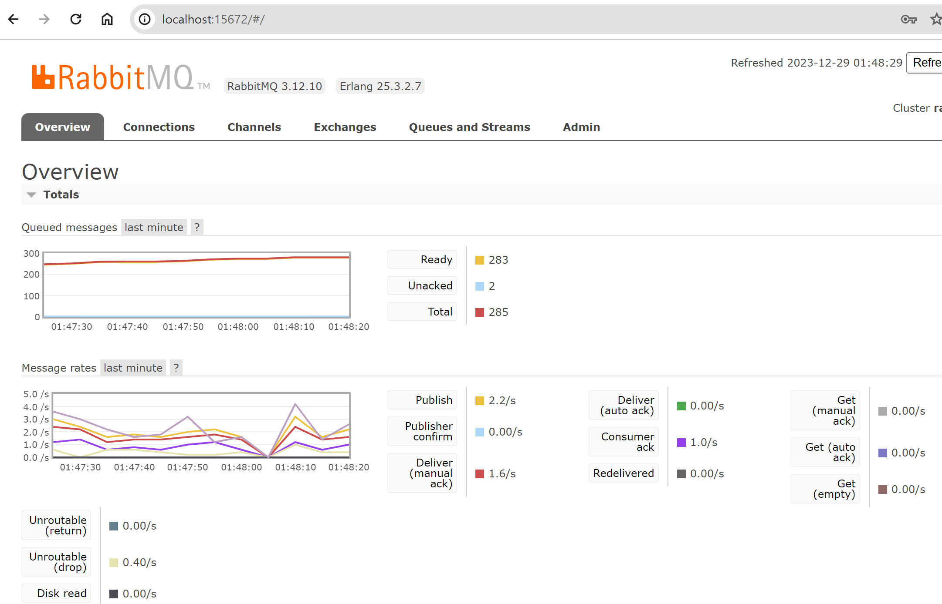
Message-driven microservices
07
Integrate with other spring cloud projects

Slide 62
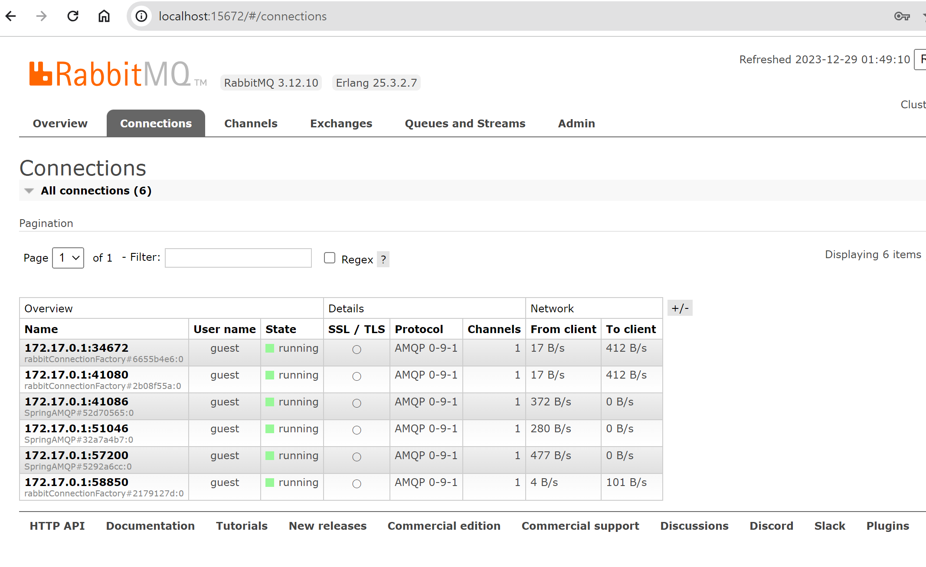
Message-driven microservices
07
Integrate with other spring cloud projects

Slide 63
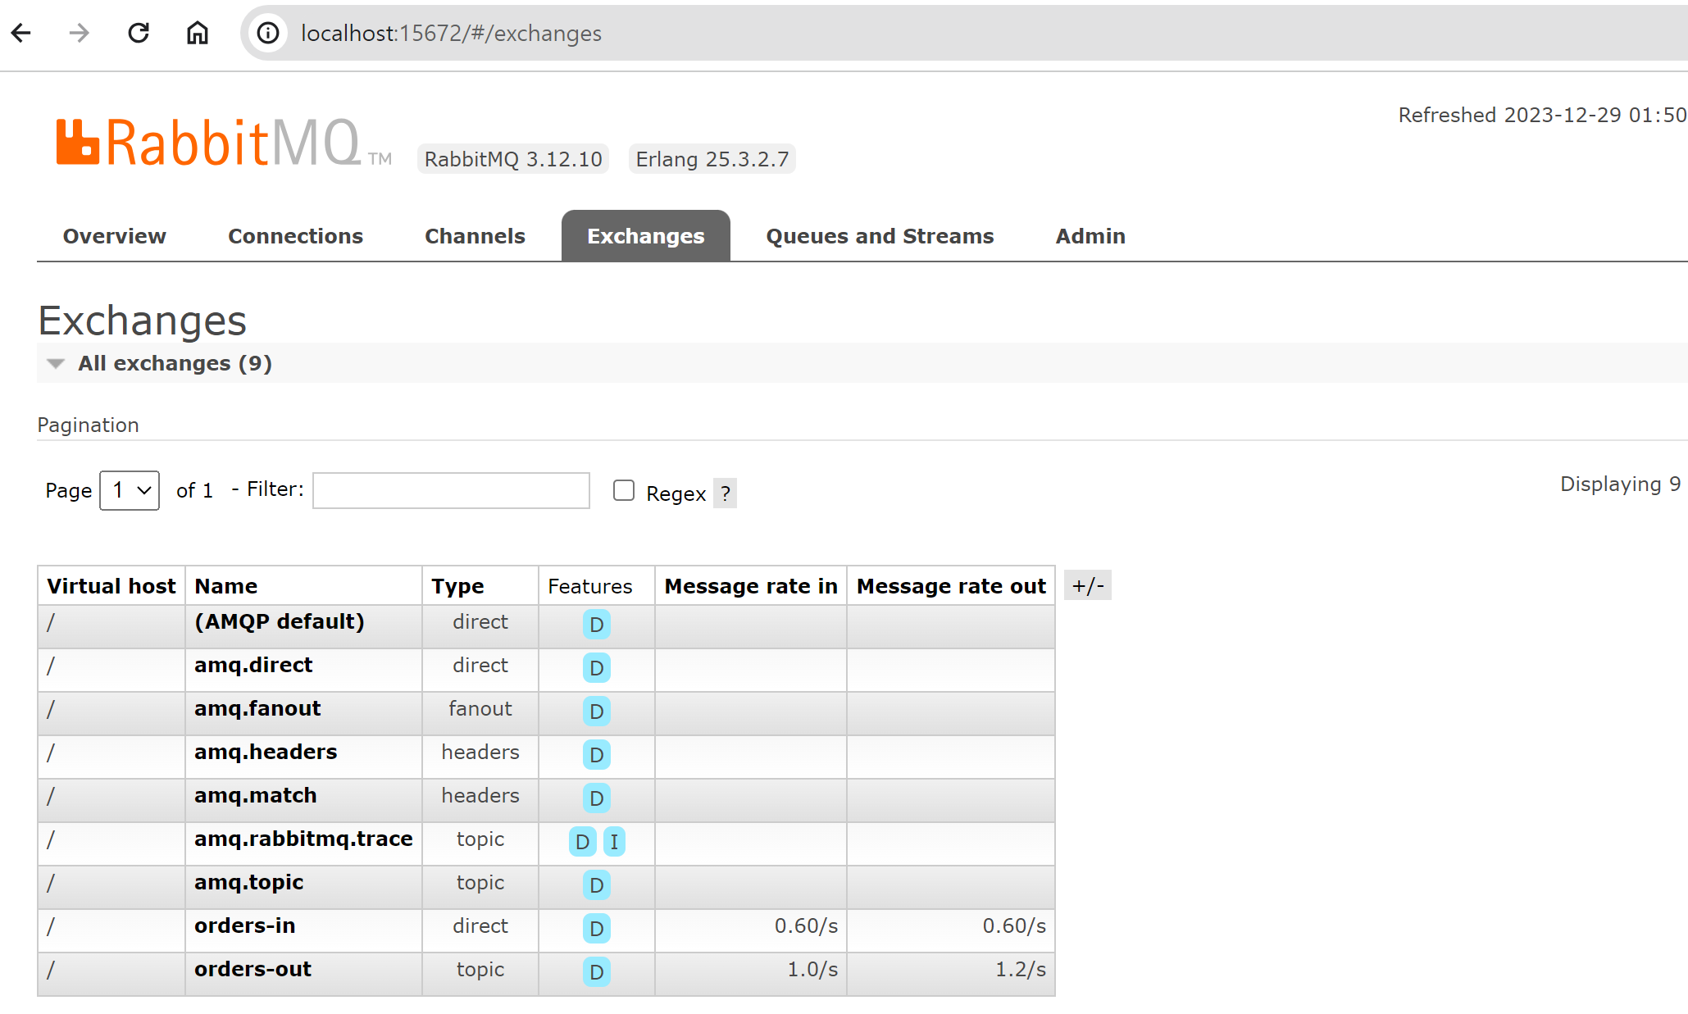
Message-driven microservices
07
Using HTTPS in the Spring Boot

Slide 64
API Security
08
Using HTTPS in the Spring Boot
Certificate must be generated to use REST API over SSL and HTTPS
You can create private certificates with the following command
Save the created certificate to src/main/resources
keytool -genkeypair -alias account-key -keyalg RSA -keysize 2048 -storetype PKCS12 -keystore account-key.p12 -validity 3650
server:
port: ${PORT:8091}
ssl:
enabled: true
key-store: classpath:account-key.p12
key-store-password: 123456
key-store-type: PKCS12
key-alias: account-key
security:
require-ssl: true

Slide 65
API Security
08
Discovery Security
Integrate microservices with discovery servers
Must post secure microservice instance information to Eureka
The discovery client must be forced to expose the Eureka server with HTTPS and authenticate the discovery server using the private key
eureka:
instance:
nonSecurePortEnabled: false
securePortEnabled: true
securePort: ${PORT:8091}
statusPageUrl: https://localhost:${eureka.instance.securePort}/info
healthCheckUrl: https://localhost:${eureka.instance.securePort}/health
homePageUrl: https://localhost:${eureka.instance.securePort}
client:
securePortEnabled: true
serviceUrl:
defaultZone: https://localhost:8761/eureka/

Slide 66
API Security
08
Eureka service over HTTPS
Standard microservices and SSL configurations are identical because Eureka servers are distributed over the embedded Tomcat container when they are spring-booted
The discovery client must authenticate directly with the Eureka server and verify the server certificate
This is referred to as two-way SSL authentication
Use keyStore and trustStore to store private keys and certificates
keyStore: Keep certificates for private keys and apps
trustStore: Archive certificates to verify third-party
All apps store the private key and certificate in the keystore, and the certificate corresponding to the public key of the discovery server in the truststore
Discovery Server stores certificates for all apps

Slide 67
API Security
08
RabbitMQ broker
Eureka service over HTTPS
account.cer
Discovery service
customer.cer
order.cer
https
product.cer
https
https
https
order.jks
product.jks
account.jks
customer.jks
Order service
Product service
Account service
Customer service

Slide 68
API Security
08
Create a keystore
Create private and public keys for use in the microservice
Use this to create a certificate
keytool -genkeypair -alias product -storetype JKS -keyalg RSA -keysize 2048 -keystore product.jks -validity 3650
keytool -genkeypair -alias order -storetype JKS -keyalg RSA -keysize 2048 -keystore order.jks -validity 3650
keytool -exportcert -alias product -keystore product.jks -file product.cer
keytool -exportcert -alias order -keystore order.jks -file order.cer

Slide 69
API Security
08
Create a keystore
The public certificate of account-servic must be included in the trustStore of the discovery server. The public certificate of the discovery server must also be stored in the trustStore of the account-server
keytool -importcert -alias discovery -keystore account.jks -file discovery.cer
keytool -importcert -alias account -keystore discovery.jks -file account.cer
keytool -importcert -alias discovery -keystore customer.jks -file discovery.cer
keytool -importcert -alias customer -keystore discovery.jks -file customer.cer
keytool -importcert -alias discovery -keystore order.jks -file discovery.cer
keytool -importcert -alias order -keystore discovery.jks -file order.cer
keytool -importcert -alias discovery -keystore product.jks -file discovery.cer
keytool -importcert -alias product -keystore discovery.jks -file product.cer

Slide 70
API Security
08
SSL configuration for microservice and eureka servers
The SSL configuration settings for the microservice are similar to using Springboot HTTPS
The difference is that JKS is used as the keystore type
Service Discovery configuration enables client certificate authentication by setting the server.ssl.client-auth attribute to necessary
You must provide trustStore with server.ssl.trust-store property
spring:
application:
name: discovery-service
server:
port: ${PORT:8761}
ssl:
enabled: true
client-auth: need
key-store: classpath:discovery.jks
key-store-password: 123456
trust-store: classpath:discovery.jks
trust-store-password: 123456
key-alias: discovery

Slide 71
API Security
08
SSL configuration for microservice and eureka servers
Conversion of cer certificates to PKCS12 format is required to access from web browsers such as chrome, firewall, etc
keytool -importkeystore -srckeystore account.jks -srcstoretype JKS -deststoretype PKCS12 -destkeystore account.p12
keytool -importkeystore -srckeystore order.jks -srcstoretype JKS -deststoretype PKCS12 -destkeystore order.p12
keytool -importkeystore -srckeystore product.jks -srcstoretype JKS -deststoretype PKCS12 -destkeystore product.p12
keytool -importkeystore -srckeystore customer.jks -srcstoretype JKS -deststoretype PKCS12 -destkeystore customer.p12
keytool -importkeystore -srckeystore discovery.jks -srcstoretype JKS -deststoretype PKCS12 -destkeystore discovery.p12

Slide 72
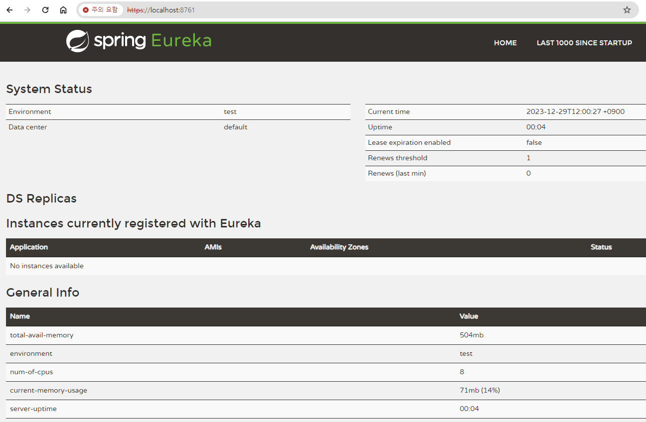
API Security
08
SSL configuration for microservice and eureka servers

Slide 73
Authorize with OAuth2
08
Introducing OAuth2
Authentication is to verify who the user is, and authorization is to authenticate what the user can do
The most popular authentication methods for REST APIs are OAuth2 and JWT. The two are complementary
OAuth2 enables fast implementation of common virtue security patterns such as single sign-on, token relay, and token exchange
OAuth grants third-party app authorization to the user authentication system to access user credentials and shared information about user accounts

Slide 74
Authorize with OAuth2
08
Introducing OAuth2
Resource Owner: Controlling Access to Resources
Empowerment: Empowerment for access. Provide various options for access control (authorization code, implicit, resource owner password credentials, client credentials, etc.)
Resource server: a server that stores the owner's resources that can be shared using special tokens
Authorization server: manages key allocation, tokens, and temporary resource access codes to access resources
Access tokens: keys to allow access to resources
client application
Request permissions
resource owner
approved permission
Authorization Approval
Authorization server
access token
access token
resource server
Protected resources

Slide 75
Authorize with OAuth2
08
Building an Empowerment Server
spring-cloud-starter-oauth2, spring-cloud-starter-security dependence
Apply @EnableAuthorizationServer to the Authorization Server main class
@SpringBootApplication
@EnableResourceServer
@EnableAuthorizationServer
public class AuthApplication {
public static void main(String[] args) {
new SpringApplicationBuilder(AuthApplication.class).web(true).run(args);
}
}
user:
name: root
password: password
oauth2:
client:
client-id: piotr.minkowski
client-secret: 123456
scope: read

Slide 76
Authorize with OAuth2
08
Building an Empowerment Server
spring-cloud-starter-oauth2, spring-cloud-starter-security Add dependencies
Apply @EnableAuthorizationServer to the Authorization Server main class
@Configuration
@EnableAuthorizationServer
public class AuthServerConfig extends AuthorizationServerConfigurerAdapter {
@Autowired
private AuthenticationManager authenticationManager;
@Override
public void configure(AuthorizationServerSecurityConfigurer oauthServer) throws Exception {
oauthServer
.tokenKeyAccess("permitAll()")
.checkTokenAccess("isAuthenticated()");
}

Slide 77
Authorize with OAuth2
08
Building an Empowerment Server
@Override
public void configure(ClientDetailsServiceConfigurer clients) throws Exception {
clients.inMemory()
.withClient(“Lee.youngkon")
.secret("123456")
.scopes("read")
.authorities("ROLE_CLIENT")
.authorizedGrantTypes("authorization_code", "refresh_token", "implicit")
.autoApprove(true)
.and()
.withClient("john.smith")
.secret("123456")
.scopes("read", "write")
.authorities("ROLE_ADMIN")
.authorizedGrantTypes("authorization_code", "refresh_token", "password")
.autoApprove(true);
}

Slide 78
Authorize with OAuth2
08
Web Security Settings
@Configuration
public class SecurityConfig extends WebSecurityConfigurerAdapter {
@Autowired
private AuthenticationManager authenticationManager;
@Override
protected void configure(HttpSecurity http) throws Exception {
http.requestMatchers()
.antMatchers("/login", "/oauth/authorize")
.and()
.authorizeRequests()
.anyRequest().authenticated()
.and()
.formLogin().permitAll();
}
@Override
protected void configure(AuthenticationManagerBuilder auth) throws Exception {
auth.parentAuthenticationManager(authenticationManager)
.inMemoryAuthentication()
.withUser("john").password("123").roles("USERS");
}

Slide 79
Authorize with OAuth2
08
Client Configuration
Two ways to use OAuth2 clients
Available via @EnableOAuth2ClientAnnotation that creates filter bin with the ID of the oauth2ClientContextFilter responsible for storing requests and contacts
@EnableOauth2Sso enabled. This notation comes with two functions: OAuth2 client and authentication.
@SpringBootApplication
@EnableDiscoveryClient
@EnableOAuth2Sso
public class AccountApplication {
public static void main(String[] args) {
new SpringApplicationBuilder(AccountApplication.class).web(true).run(args);
}
}

Slide 80
Authorize with OAuth2
08
Client Configuration
@Configuration
@EnableOAuth2Sso
public class WebSecurityConfig extends WebSecurityConfigurerAdapter {
@Override
protected void configure(HttpSecurity http) throws Exception {
http.antMatcher("/**")
.authorizeRequests()
.antMatchers("/", "/login**")
.permitAll()
.anyRequest()
.authenticated();
}
}

Slide 81
Authorize with OAuth2
08
Client Configuration
security:
basic:
enabled: false
oauth2:
client:
clientId: piotr.minkowski
clientSecret: 123456
accessTokenUri: http://localhost:9999/oauth/token
userAuthorizationUri: http://localhost:9999/oauth/authorize
resource:
userInfoUri: http://localhost:9999/user

Slide 82
Authorize with OAuth2
08
Using JDBC Backend Repository
spring:
application:
name: auth-service
datasource:
url: jdbc:mysql://localhost:3306/oath2?useSsl=false
username : oauth2
password: oauth2
driver-class-name: com.mysql.jdbc.Driver
schema: classpath:/script/schema.sql
data: classpath:/script/data.sql

Slide 83
Docker Support
09
Dockerfile
FROM: Initialize a new build phase and set the default image for subsequent indicators
MAINTAINER: Author Identifier
RUN: Executes Linux commands to install and configure S/Ws needed for new layers on the current image and commit results
ENTRYPOINT: Configures the final script used when the container is started. This uses CMD to override all specified elements
CMD: Dockerfile can only have one CMD indicator. This indicator provides the default input value to ENTRYPOINT in JSON array format
ENV: Set an environment variable in the form of a key/value in the container
COPY: Copy the specified file or directory to the specified target path inside the container
ADD: Alternative to COPY indicators
WORKDIR: Set the working directory to be used by RUN, CMD, ENTRYPOINT, COPY
EXPOSE: Informs docker to wait on the specified network port while running. Does not actually publish the port. Port is published as docker run –p
VOLUME:creating mount points with the specified name

Slide 84
Docker Support
09
Dockerfile Example
FROM openjdk:8u151-jdk-slim-stretch
MAINTAINER Youngkon Lee <yklee2002@gmail.com>
ENV SPRING_PROFILES_ACTIVE zone1
ENV EUREKA_DEFAULT_ZONE http://localhost:8761/eureka/
ADD target/account-service-1.0-SNAPSHOT.jar app.jar
ENTRYPOINT ["java", "-Xmx160m", "-jar", "-Dspring.profiles.active=${SPRING_PROFILES_ACTIVE}", "-Deureka.client.serviceUrl.defaultZone=${EUREKA_DEFAULT_ZONE}", "/app.jar"]
EXPOSE 8091

Slide 85
Docker Support
09
Maven build after Dockerfile is ready
Run from the root directory of the microservice when building the docker image
Docker image build-type 2002/discovery-service:latest
Create a network on which containers containing micro-services will run
docker run – used as input value for network
docker network create sample-spring-cloud-network
docker run -d —name discovery -p 8761:8761 —network sample-spring-cloud-network yklee2002/discovery-service:latest
docker run -d —name account -p 8091:8091 -e EUREKA_DEFAULT_ZONE=http://discovery:8761/eureka -m 256m —network sample-spring-cloud-network yklee2002/account-service:latest
docker run -d —name order -p 8090:8090 -e EUREKA_DEFAULT_ZONE=http://discovery:8761/eureka -m 256m —network sample-spring-cloud-network yklee2002/order-service:latest
docker run -d —name product -p 8093:8093 -e EUREKA_DEFAULT_ZONE=http://discovery:8761/eureka -m 256m —network sample-spring-cloud-network yklee2002/product-service:latest
docker run -d —name customer -p 8092:8092 -e EUREKA_DEFAULT_ZONE=http://discovery:8761/eureka -m 256m —network sample-spring-cloud-network yklee2002/customer-service:latest
docker run -d —name gateway -p 8095:8095 -e EUREKA_DEFAULT_ZONE=http://discovery:8761/eureka -m 256m —network sample-spring-cloud-network yklee2002/gateway-service:latest

Slide 86
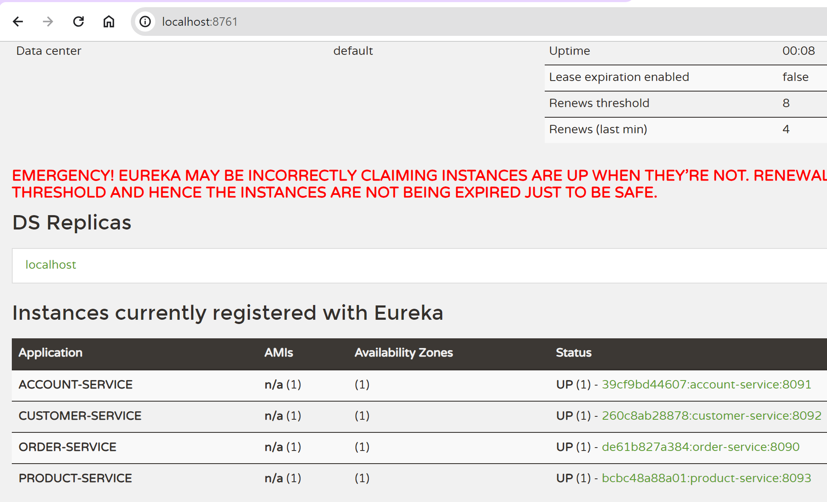
Docker Support
09
Run a containerized microservice

Slide 87


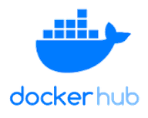
Integrating Jenkins into Dockers
09
Jenkins
Use Jenkins and Docker to design and execute local delivery processes
Download and build the source from GitHub, make the resulting JAR into a docker image, upload it to the docker hub, and finally run the container containing the microservices
Required Plug-in
Pipeline: Collection of plug-ins to help with automation
Docker Pipeline: Build Docker Containers From Pipeline
GIT: Integrating Jenkins with Git
Maven Integration: Provides useful commands for building apps using Maven and Jenkins
Github
Jenkins
Master
Jenkins
Slave
Docker
Hub
checkout
build
push
Jenkins Master

Slide 88
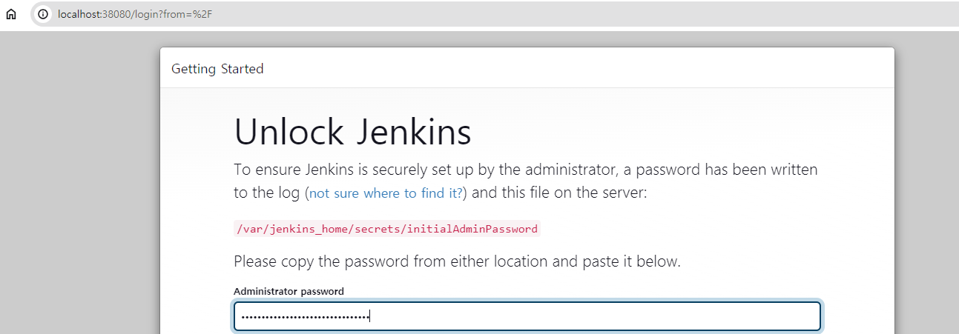
Integrating Jenkins into Dockers
09
Jenkins
After creating Jenkins network, start Jenkins container, expose UI dashboard to 38080 port
Password extractable with docker logs Jenkins command
Subsequent slave nodes must be added
docker network create jenkins
docker run -d —name jenkins -p 38080:8080 -p 50000:50000 jenkins/jenkins:lts
docker logs jenkins

Slide 89
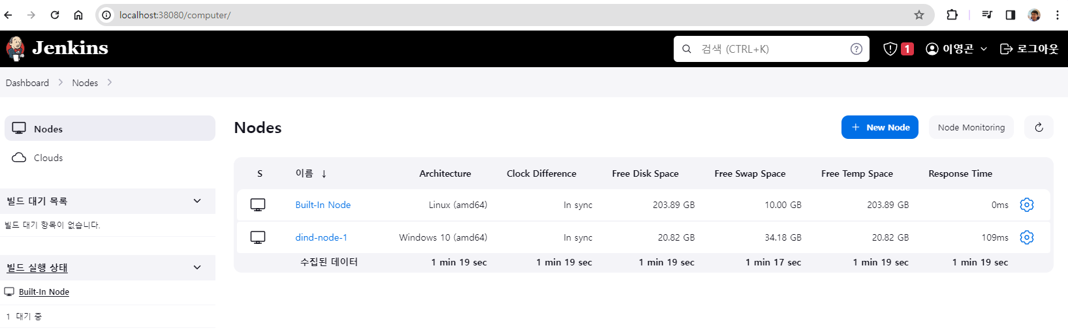
Integrating Jenkins into Dockers
69209753ccec37277b2e9391def6b4d4e1127ced6ec543f911f3d8027be1f7b1
09
Jenkins
After configuring the master node, you must add a new slave node
To do this, go to the Manage Jenkins/Manage Nodes section and select a New Node
You must set /home/jenkins as the remote root directory at this time
Running agent with Java web start
Jenkins Slaves can then run as docker containers
Override two environmental variables that refer to the slave's name and password
secret-file & curl.exe -sO http://localhost:38080/jnlpJars/agent.jar & java -jar agent.jar -jnlpUrl http://localhost:38080/computer/dind%2Dnode%2D1/jenkins-agent.jnlp -secret @secret-file -workDir “/home/jenkins“

Slide 90
Integrating Jenkins into Dockers
09
Building Pipeline
Jenkins Pipeline is designed to model simple and advanced deployment pipelines in code
Save to a text file called Jenkinsfile
Logically divided into stages and steps
Step: Jenkins tells you what to do
Stage: Logical group of steps displayed on the results screen of the pipeline

Slide 91
Integrating Jenkins into Dockers
09
node('dind-node-1') {
withMaven(maven:'M3') {
stage('Checkout') {
git url: 'https://github.com/leeyoungkon/springcloud.git', credentialsId: 'leeyoungkon', branch: 'docker'
}
stage('Build') {
dir('account-service') {
sh 'mvn clean install'
}
def pom = readMavenPom file:'pom.xml'
print pom.version
env.version = pom.version
currentBuild.description = "Release: ${env.version}"
}
stage('Image') {
dir ('account-service') {
def app = docker.build "yklee2002/account-service:${env.version}"
//app.push()
}
}
stage ('Run') {
docker.image("yklee2002/account-service:${env.version}").run('-p 8091:8091 -m 256M -e EUREKA_DEFAULT_ZONE=http://discovery:8761/eureka -d --name account --network sample-spring-cloud-network')
}
}
}

Slide 92
Integrating Jenkins into Dockers
09
Building Pipeline
Jenkins Pipeline is designed to model simple and advanced deployment pipelines in code
Save to a text file called Jenkinsfile
Logically divided into stages and steps
Step: Jenkins tells you what to do
Stage: Logical group of steps displayed on the results screen of the pipeline

